Slide 1
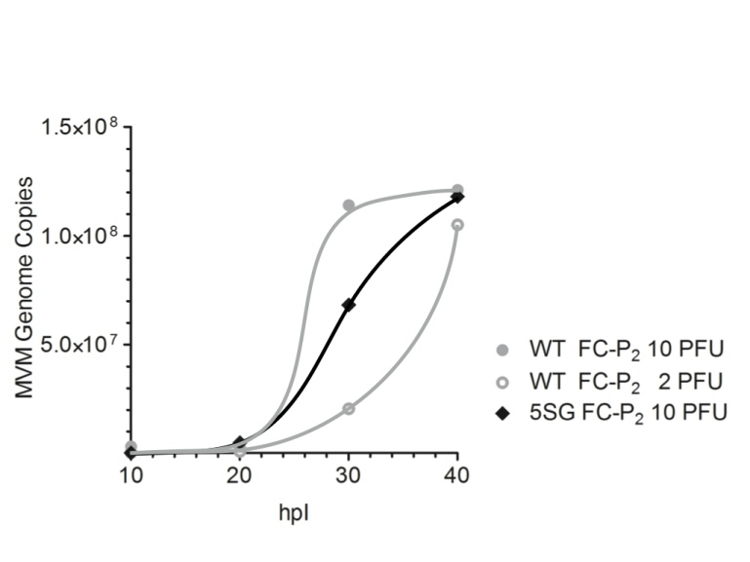
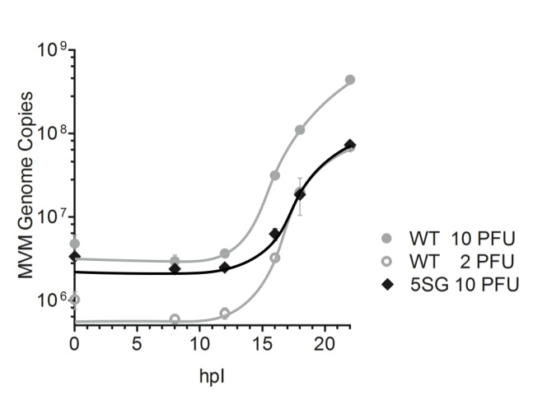
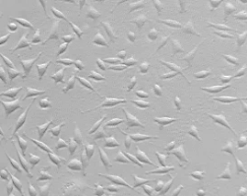
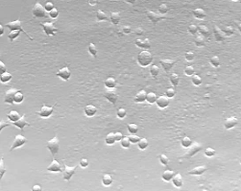
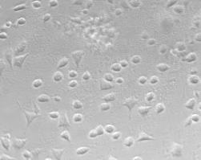
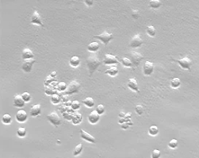
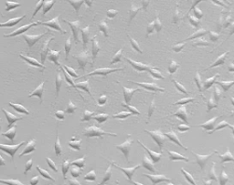
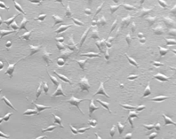
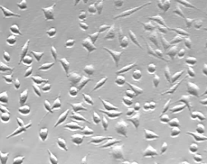
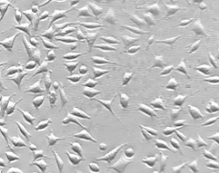
A
Nuclear import
(Viral DNA replication)
B
Nuclear export
C
Cytotoxicity
10 h
20 h
30 h
40 h
WT
99 %
100 %
98 %
58 %
5SG
99 %
96 %
90 %
88 %

Slide 2
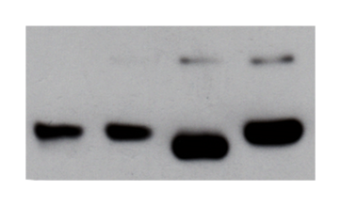
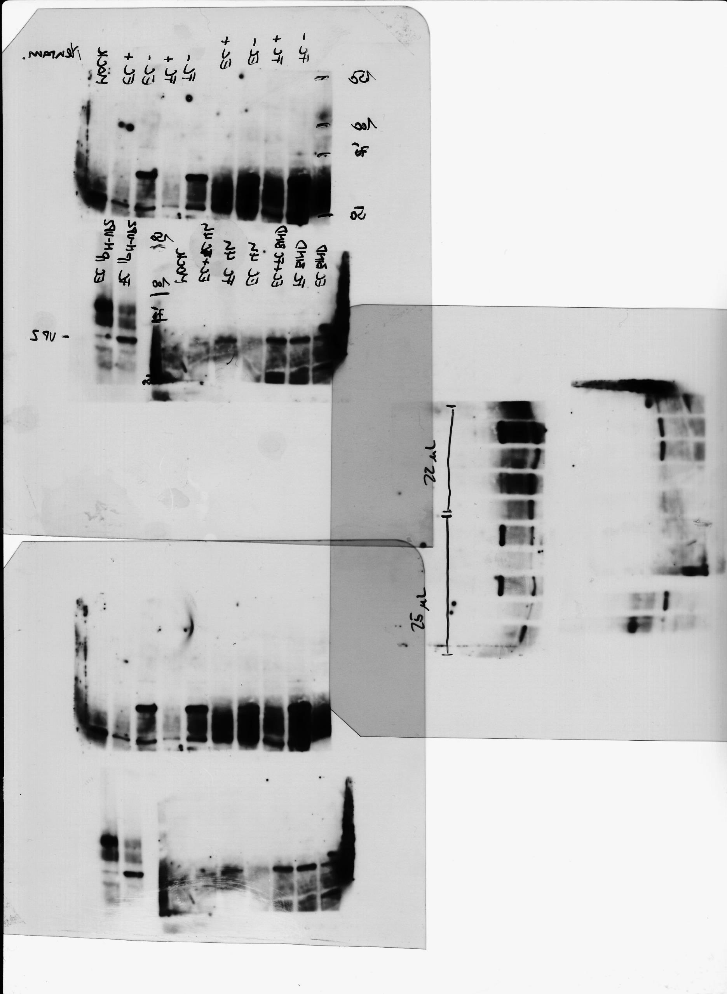
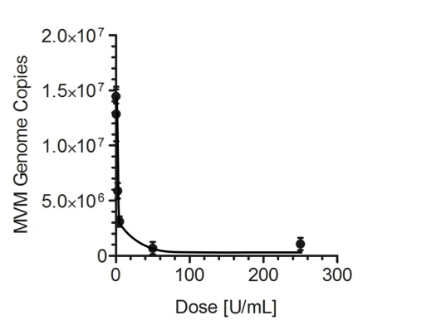
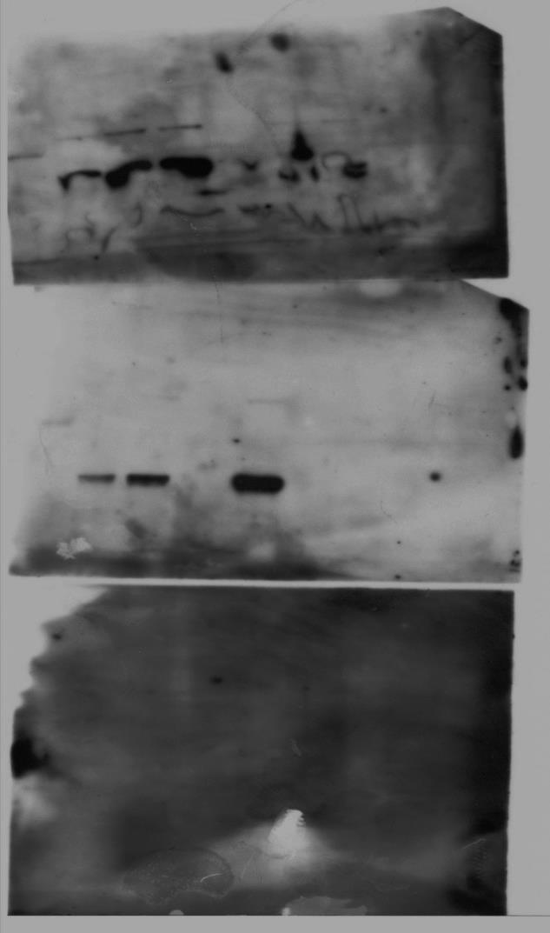
A
Top
Bottom
B
C
D
EC IP^{N-VP2}
FC IP^{B7}
FC IP^{N-VP2}
FC EC FC EC
- - + + Cht
EC IP^{B7}
VP1
VP1
VP2
VP2
VP3
A
B
EC
FC
FC
EC
EC
5
5
5
25
25
PFU⁶
-
-
+
-
+
Neur
VP1
VP2

Slide 4
A
B
C
D
E

Slide 5

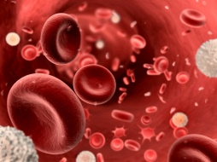
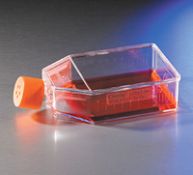
A
B
B19V
CPV
Bone marrow:
Site of production
Blood:
Mature virions
Cell culture:
Pre-mature and mature virions are not separated
C
D
E
F
B19V purified from plasma
B19V binding
B19V internalization
(3 h)
CPV SN + Cell

Slide 6

1 2 3 4 5 6 7 8 9 10 11 12 13 14 15 16 17 18 19 20 21 22 23 24
Empty Capsids
Full Capsids

Slide 7
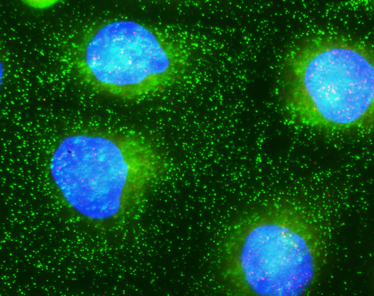
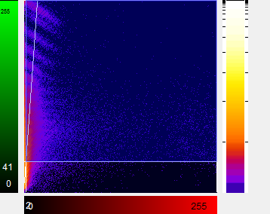
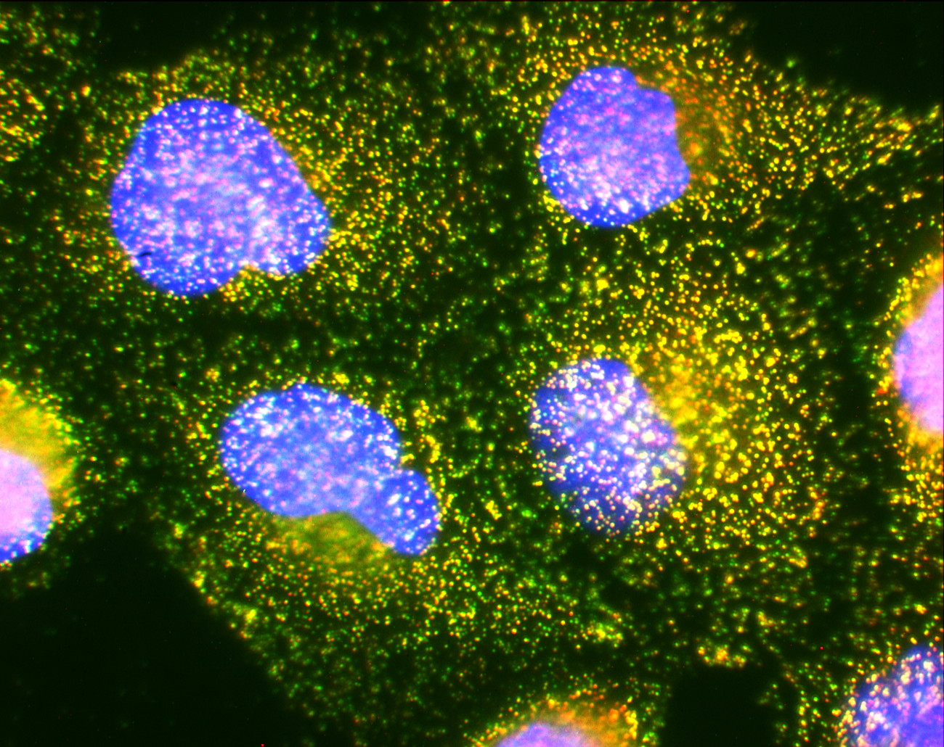
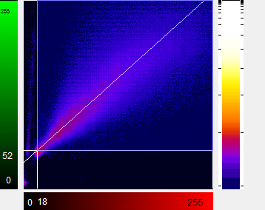
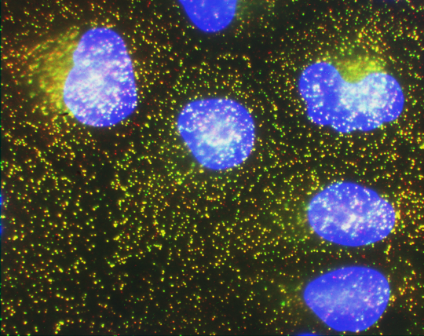
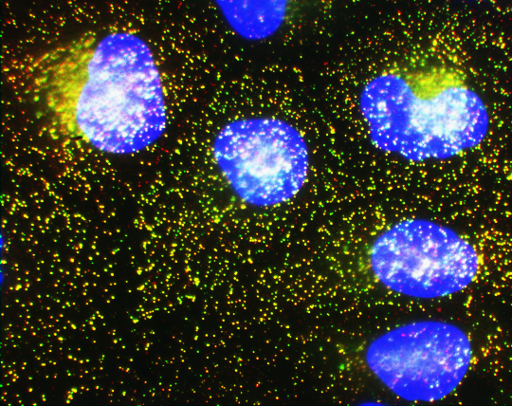
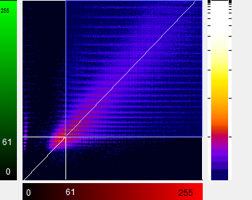
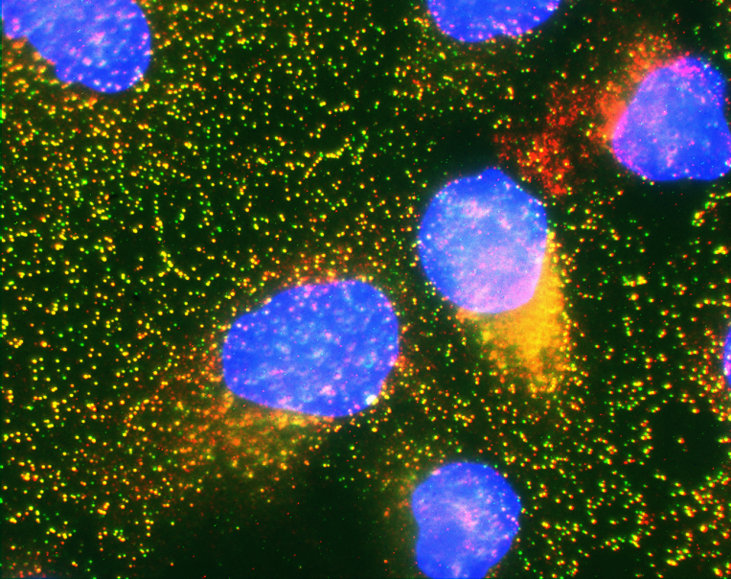
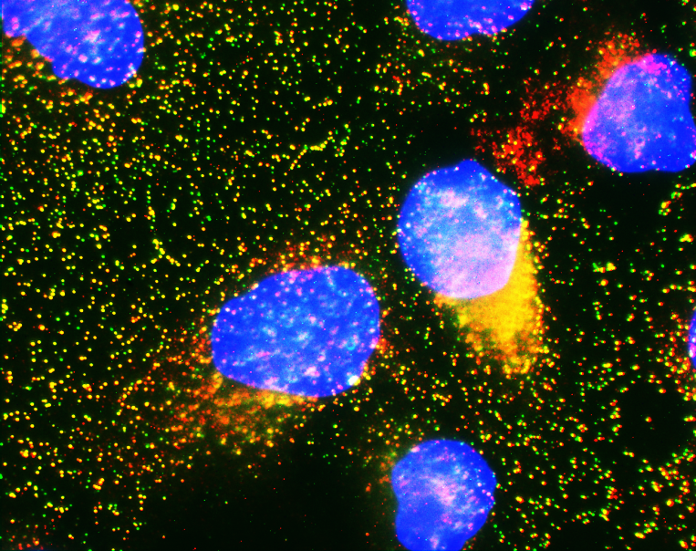
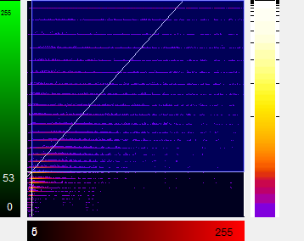
A
B
Binding
Amplification
Scatter Plot
EC
FC
EC + FC
EC(30’) + FC
α-capsid
α-N-VP2

Slide 8
A
Transfection in NB324K cells
48 hpt WT
48 hpt NES-22
B
Infection in A9 cells
14 hpi
26 hpi
WT
NES-22

